Slide 1
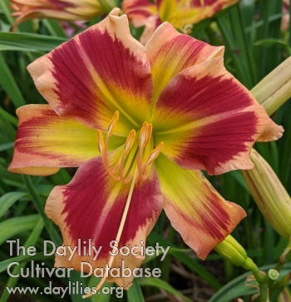
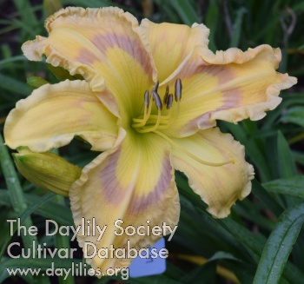
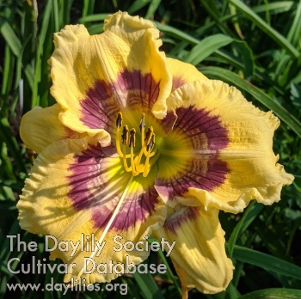
2023 CCDS ARMS Auction
September 23, 2023 Meeting

Slide 2
I Believe in Unicorns (Marchant, 2022)
Scape 28”
Bloom 6”
Bud Count 20
Branching 4
Mid-season
Tet, Dormant

Slide 3
Ripples of Hope (Marchant, 2022)
Scape 37”
Bloom 7”
Bud Count 18
Branching 3
Mid-season
Dip, Semi-Evergreen

Slide 4
Chapstick Blonde (Marchant, 2021)
Scape 30”
Bloom 6.5”
Bud Count 20
Branching 4
Mid-season
Dip, Dormant

Slide 5
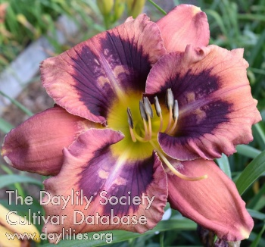
Shattered Image (Marchant, 2021)
Scape 28”
Bloom 6”
Bud Count 18
Branching 3
Dip, Dormant

Slide 6
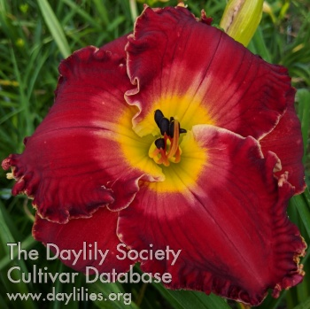
Insurrection (Marchant, 2021)
Scape 30”
Bloom 7”
Bud Count 20
Branching 4
Mid-season
Tet, Semi-evergreen

Slide 7
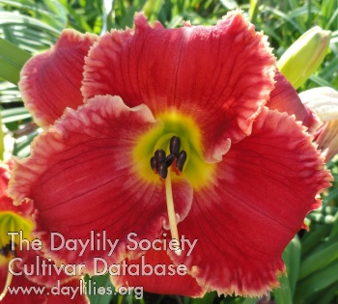
Druid City Crimson Tutu (Marchant, 2019)
Scape 27”
Bloom 6”
Bud Count 18
Branching 3
Mid-season
Tet, Semi-evergreen

Slide 8
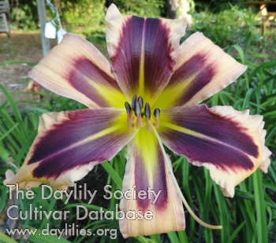
Queen of the Damned (Marchant, 2019)
Scape 34”
Bloom 6”
Bud Count 25
Branching 4
Mid-season
Dip, Dormant

Slide 9
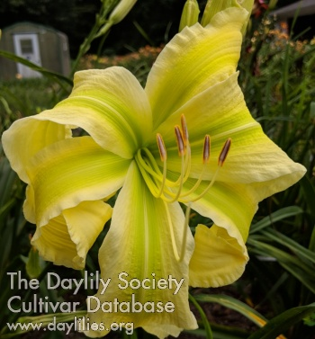
From Here to the Moon and Back (Marchant, 2019)
Scape 34”
Bloom 7”
Bud Count 15
Branching 3
Mid-season
Dip, Dormant
UF Cascade

Slide 10
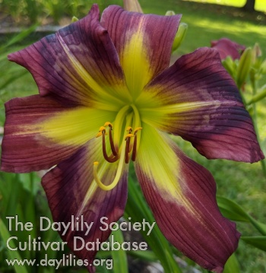
Hillbilly Homecoming (Marchant, 2019)
Scape 27”
Bloom 6”
Bud Count 15
Branching 3
Mid-season
Dip, Dormant

Slide 11
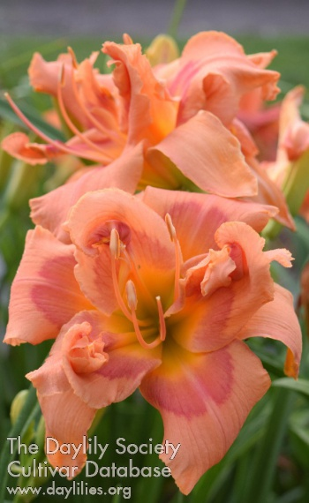
Viva Va Boom (Marchant, 2018)
Scape 31”
Bloom 6”
Bud Count 15
Branching 3
Mid-season
Tet, Semi-evergreen
Double 95%

Slide 12
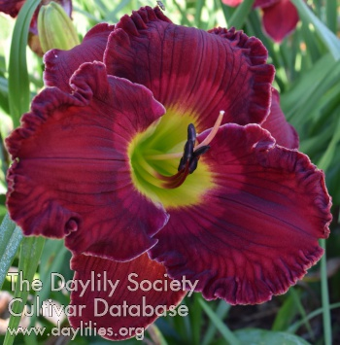
Roar with Pride (Marchant, 2018)
Scape 27”
Bloom 6”
Bud Count 15
Branching 3
Mid-season
Tet, Semi-evergeen

Slide 13
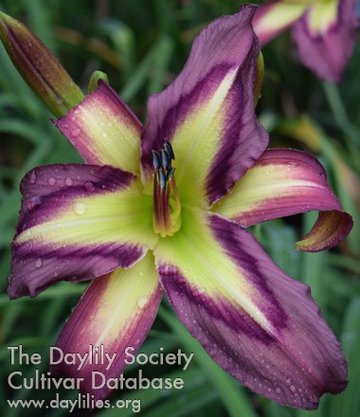
Galactic Starburst (Marchant, 2017)
Scape 29”
Bloom 7”
Bud Count 20
Branching 4
Mid-season
Dip, Dormant
UF Crispate

Slide 14
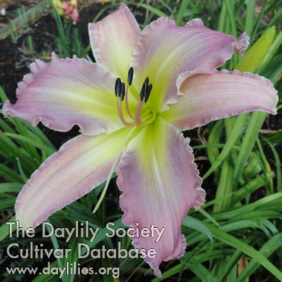
Min Alskade Far (Marchant, 2017)
Scape 27”
Bloom 6.5”
Bud Count 24
Branching 5
Mid-season
Dip, Dormant

Slide 15
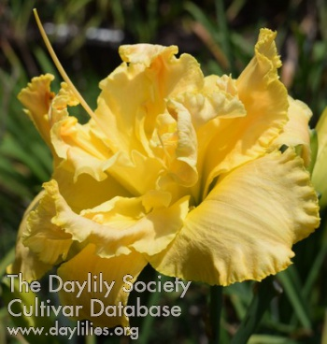
Southern Sunrise (Marchant, 2017)
Scape 32”
Bloom 6”
Bud Count 25
Branching 5
Mid-season
Tet, Semi-evergreen
Double 100%

Slide 16
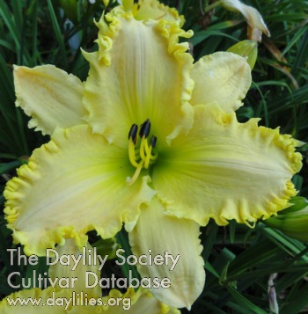
Splendid Sarah (Marchant, 2017)
Scape 30”
Bloom 6”
Bud Count 15
Branching 3
Mid-season
Tet, Dormant

Slide 17
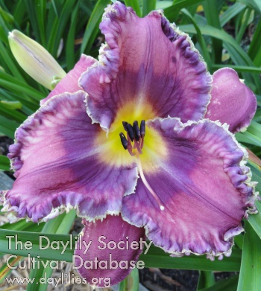
Wandaful (Marchant, 2015)
Scape 22”
Bloom 5.5”
Bud Count 20
Branching 3
Mid-season
Tet, Semi-evergreen

Slide 18
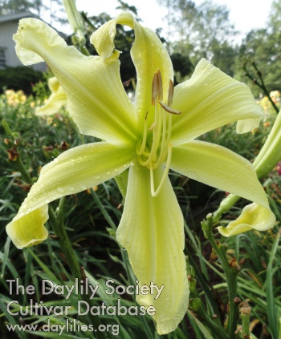
Shootin’ the Hooch (Marchant, 2015)
Scape 40”
Bloom 6.5”
Bud Count 30
Branching 5
Early Mid-season
Dip, Dormant
UF Crispate-Spatulate

Slide 19
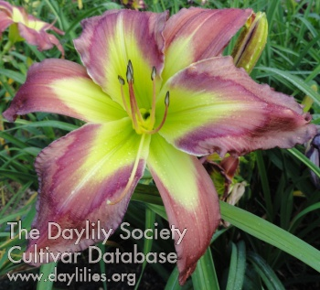
Taste the Rainbow (Marchant, 2015)
Scape 28”
Bloom 7”
Bud Count 21
Branching 4
Early Mid-season
Dip, Dormant

Slide 20
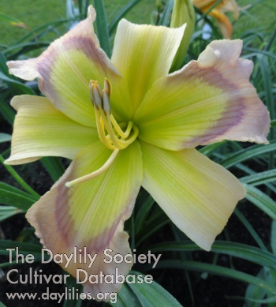
Life’s a Beach (Marchant, 2015)
Scape 26”
Bloom 6.5”
Bud Count 20
Branching 4
Early Mid-season
Dip, Dormant

Slide 21
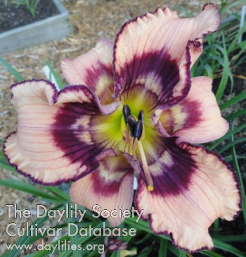
Look At That! (Marchant, 2017)
Scape 29”
Bloom 5”
Bud Count 15
Branching 4
Mid-season
Tet, Semi-evergreen

Slide 22
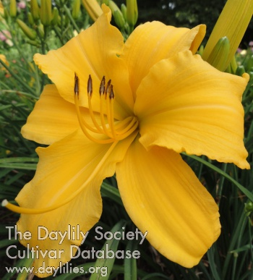
Hitting the Jackpot (Marchant, 2015)
Scape 36”
Bloom 7”
Bud Count 38
Branching 5
Mid-season
Dip, Dormant

Slide 23
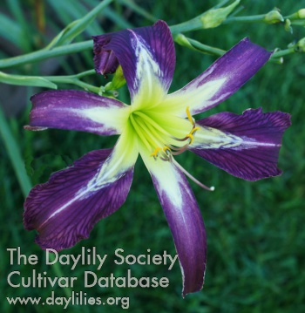
Zebra Power (Gossard, 2015)
Scape 43”
Bloom 9.5”
Bud Count 22
Branching 5
Early Mid-season
Dip, Dormant
UF Crispate-Cascade

Slide 24
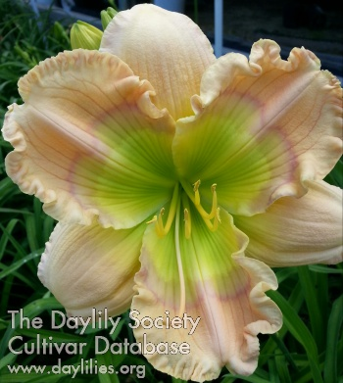
Lush Oasis (Rea, 2016)
Scape 36”
Bloom 6.5”
Bud Count 18
Branching 3
Mid-season
Dip, Evergreen

Slide 25
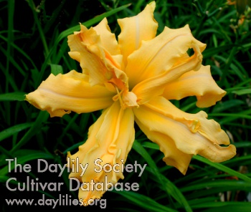
Magical Explosion (Gossard, 2015)
Scape 43”
Bloom 8”
Bud Count 24
Branching 5
Early Mid-season
Dip, Dormant
Spider 4.4:1/Double 99%
UF Crispate-Cascade

Slide 26
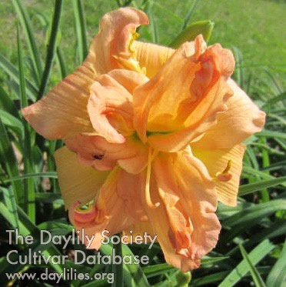
Born in Carolina (Bruce, 2016)
Scape 28”
Bloom 6.25”
Bud Count 21
Branching 3
Mid-season
Tet, Semi-evergreen
Double 96%

Slide 27
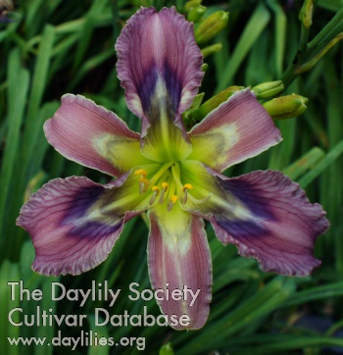
New Design (Gossard, 2015)
Scape 40”
Bloom 5”
Bud Count 28
Branching 5
Mid-season
Dip, Dormant
UF Crispate-Cascade

Slide 28
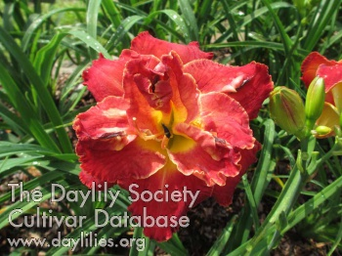
Red Ragtop (Bruce, 2015)
Scape 29”
Bloom 5.75”
Bud Count 20
Branching 3
Early Mid-season
Tet, Semi-evergreen
Double 100%

Slide 29
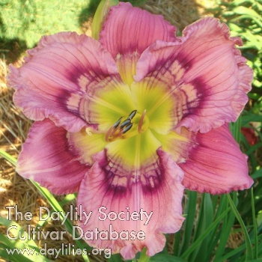
Interstellar (Reimer, 2016)
Scape 34”
Bloom 6”
Bud Count 25
Branching 3
Midseason-Late
Dip, Dormant

